Slide 1



SMART INDIA HACKATHON 2025
TITLE PAGE
Problem Statement ID:– SIH25089
Problem Statement Title:- One-Stop Personalized Career & Education Advisor
Theme:- Personalized learning assistant
PS Category:- Software
Team ID:-
Team Name (Registered on portal) : Nova

Slide 2

ReCall - AI Powered Cross Platform Study Companion
Nova
Idea / Solution:-
Problem Resolution:-
Detailed Explanation:
➜Capture from books, PDFs, handwritten notes, images.
➜ AI auto-generates summaries, quizzes, flashcards.
➜ Works offline-first, syncs across devices.
➜ Adds gamification (streaks, XP, badges) for engagement.
How it Addresses the Problem:
➜ Saves 30–40% study time with automation.
➜ Ensures accessibility for low-bandwidth learners.
Innovation & Uniqueness:
➜ AI that thinks like a teacher (not just a notes app).
➜ Combines OCR + AI + gamification in one platform.
➜ Offline-first architecture → rare in EdTech, tailored for India.
Students juggle multiple fragmented tools (notes apps, flashcard apps, quiz platforms).
Manual effort needed to summarize, create flashcards/quizzes.
Poor accessibility in rural areas due to online-only solutions.
Lack of engagement & motivation → study fatigue.

Slide 3

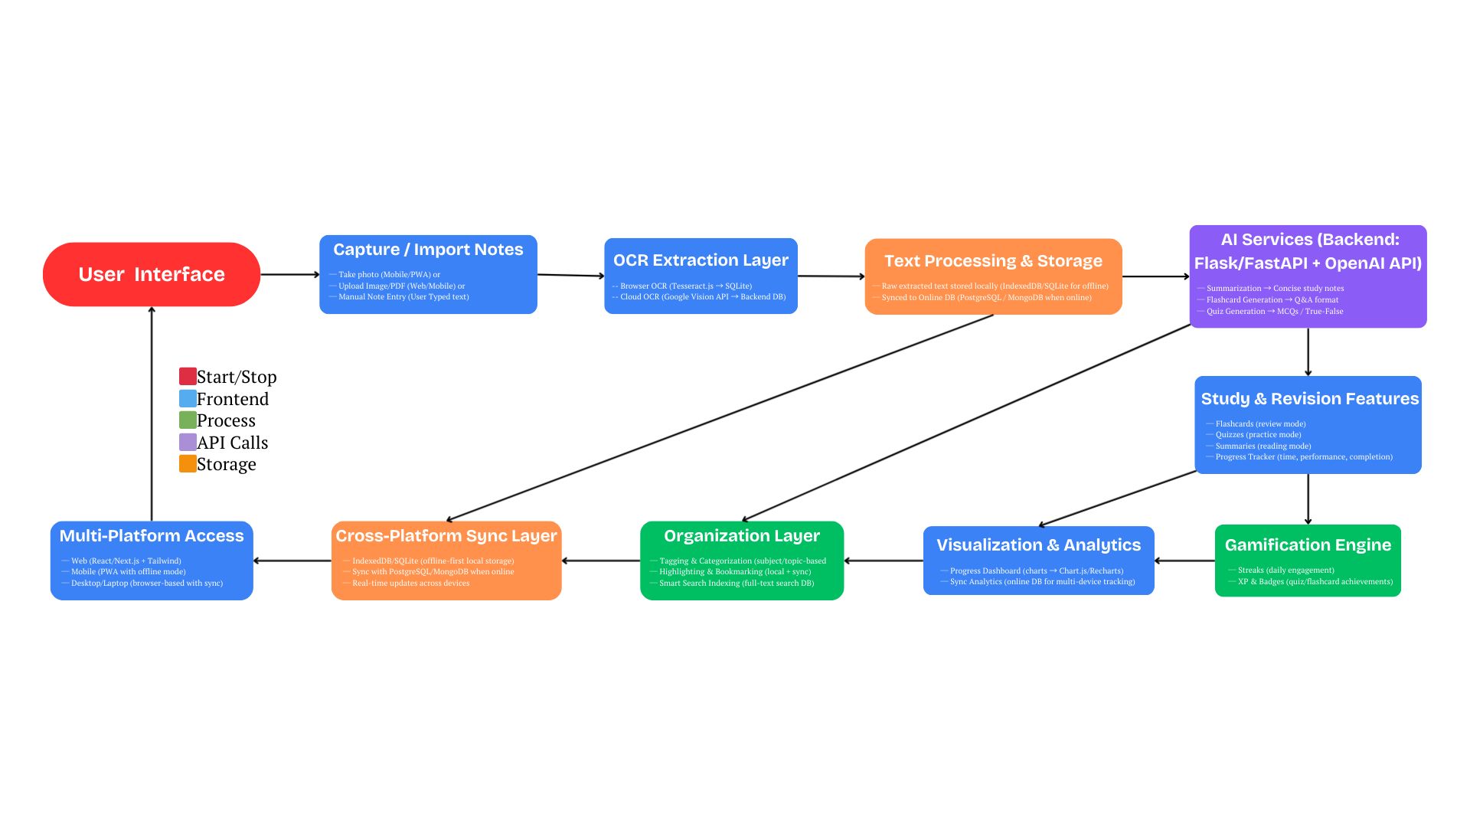
System Architecture & Workflow
Nova
Key Components:
➜ Frontend (Web/Mobile PWA): Note-taking, highlighting, flashcards, quizzes.
➜ Backend (AI Engine): OCR + NLP + Quiz Generation.
➜ Database: IndexedDB/SQLite (offline) + PostgreSQL/MongoDB (cloud sync).
➜ Cloud Services: Vercel (web hosting), Firebase/AWS (sync & storage).
Flow of Data:
➜ Capture (Text/PDF/Image/Voice) → OCR → AI Summarizer → Quizzes/Flashcards → Store Offline/Sync → Dashboard.
Highlight:
➜ Offline-first storage → Seamless sync when internet available.
➜ Gamified layer → Progress tracking + motivation.

Slide 4
FEASIBILITY AND VIABILITY
Nova
Analysis of Feasibility:-
Technical: Uses proven tech stack (React, PWA, OCR, OpenAI).
Operational: Offline-first ensures usability even in low-bandwidth zones.
Market: Huge target base – 250M+ Indian students, $9B+ exam prep market.
Financial: Low initial infra cost (PWA + APIs), scalable to freemium model.
Potential Challenges & Risks:-
AI Costs: Heavy API usage for summarization/quiz generation.
Data Privacy: Sensitive student notes.
Sync Conflicts: Offline vs. online data mismatches.
Adoption: Getting students to switch from fragmented tools.
Strategies for Overcoming Challenges:-
Local caching & batch sync → reduces API costs.
End-to-end encryption & local-first storage → ensures privacy.
Conflict resolution algorithms → safe sync.
Gamification & smart UI → strong adoption & retention.

Slide 5
IMPACT AND BENEFITS
Nova
Efficiency:– Saves 30–40% study time with AI summaries & flashcards.
Scalability:- PWA + cloud sync → works for 1 to 1M students seamlessly.
Accessibility:- Offline-first design empowers learners in low-connectivity rural areas.
Engagement:- Gamification (streaks, XP, badges) keeps learners motivated.
National Impact:- Supports Digital India & Skill India by making advanced learning tools accessible to all.

Slide 6
RESEARCH AND REFERENCES
Nova
Google Vision API, Tesseract.js
OpenAI API
Research: Gamification in Learning (2022), AI in Education (2023)
KPMG: India Online Learning Market 2024
Gap vs. Notion/Quizlet/Anki → fragmented, online-only; we unify + offline.

Slide 7
IMPORTANT INSTRUCTIONS
Please ensure below pointers are met while submitting the Idea PPT:
Kindly keep the maximum slides limit up to six (6). ( Including the title slide)
Try to avoid paragraphs and post your idea in points /diagrams / Infographics /pictures
Keep your explanation precise and easy to understand
Idea should be unique and novel.
You can only use provided template for making the PPT without changing the idea details pointers (mentioned in previous slides).
You need to save the file in PDF and upload the same on portal. No PPT, Word Doc or any other format will be supported.
Note - You can delete this slide (Important Pointers) when you upload the details of your idea on SIH portal.

